Slide 1
Bayside Peninsula Integrated Family Violence Partnership
Family Law Webinar
25th of March 2024

Slide 2
Acknowledgement of Country

Slide 3
Program
Time | Agenda Item | Host
09.30am | Webinar Welcome | Cassandra Lar
09.35am | Peninsula Community Legal Centre – Family Law Amendments | Alison Laird – Practice Manager
10:15am | Break
10:25am | Family Law Case Study | Leeah Caverzan & Lloyd Murphy
11:05am | Responses to pre-submitted questions | Alison Laird, Leeah Caverzan & Lloyd Murphy
11:25am | Close & Evaluation | Cassandra Lar

Slide 4
Changes to the Family Law Act
Alison Laird (she/her)
Acting Practice Manager - Family Lawyer 25 March 2024

Slide 5
Acknowledgement of Country
I acknowledge the Traditional Owners of the land on which I am speaking from today, the Bunurong/Boon Wurrung people of the Kulin Nation. I pay my respects to their Elders, past and present.

Slide 6
Changes are coming …
The law about parenting orders has changed:
Changes start 6 May 2024.
Goals: Simpify the law, prioritise the best interests of the child and elevate safety.
Years of advocacy have led to the reforms.
Much to like at this stage.
Parents who are not before Court but trying to work out arrangements will also need to understand the changes.
Today will cover most important changes for victim-survivors of family violence.

Slide 7
Parenting orders generally
Parenting orders cover things like:
Spend time arrangements
Responsibility for making decisions about major long-term issues (education, religion, healthcare).
Courts must always make parenting orders that are in the best interests of the child.
This won’t change.
Best interests of child will remain at centre of parenting decisions both in and outside the Courtroom.

Slide 8
What are the changes?
Goal: simpler, safer and more accessible family law system.
Main changes:
Changes to what a Court must consider when deciding what is in a child’s best interests.
Changes to the law about how separated parents make decisions about major issues (parental responsibility).
Also Information Sharing Bill – Court can obtain better information about family violence and other risks.
Changes won’t affect existing final orders.

Slide 9
Deciding best interests of child
Clunky and confusing list of considerations gone.
Now 6 simplified factors a Court must consider:
1) Safety: safety of the child and people who care for the child.
2) Child’s views: any views expressed.
3) Child’s needs: developmental, psychological, emotional, cultural.
4) Capacity: capacity to provide for the above needs.
5) Benefit to child of relationship: with their parents and other people who are significant to them (e.g. grandparents or siblings).
6) Catch all: anything else that is relevant to particular circumstances of child.
Aboriginal and Torres Strait Islander children: additional factor –right to culture - how parenting arrangements will help child to experience their culture.

Slide 10
Family violence and Safety
Focus on family violence in reforms.
Language of “safety” not previously used in Act, but now prominent feature.
1st consideration in list: “What arrangements would promote the safety of both the child and each person who has care of the child” (including safety from family violence, abuse, neglect, or other harm).
Looks at safety of child and other caregivers explicitly.
New s60CC(3): FV history, FVIOs, abuse & neglect.
New Information Sharing provisions assist more information about safety/risk to be put before Court - safer outcomes.

Slide 11
Making long-term decisions then
Education (schools), religion and healthcare as examples.
Presumption of “equal shared parental responsibility” (ESPR) gone.
Presumption related to making joint decisions about major long-term decisions BUT often misunderstood to create a right to “equal time” arrangements.
If Court made order for ESPR, had to consider making order for equal time or substantial and significant time – led to confusion about law. Courts and lawyers often “danced” through these.
Concerns misunderstanding meant parents agreed to unsafe or unfair arrangements, or matters would not settle.
Commonly held view: MRA groups lobbied for ESPR regime
New language: “joint” not “equal” – removes loaded language.

Slide 12
Making long-term decisions now
Court doesn’t have to presume in best interests of child for parents to make long-term decisions jointly.
Court now only considers what is in best interests of child on case-by-case basis.
Many victim-survivors seek sole parental responsibility to they don’t have to consult with perpetrator. Perhaps now not on back foot?
New provision – parents encouraged to consult on long-term issues unless not safe to do so or Court order otherwise,
Unclear how Courts will interpret this.
Clients may need legal advice as potential grey areas.

Slide 13
Independent Children’s Lawyers
Represent child’s best interests in family law cases.
New requirement for ICLs to meet with child and provide an opportunity to express a view.
Does not apply to children under 5.
Aims to better facilitate the participation of children in FL cases while safeguarding their wellbeing.
Child can refuse! There is no compulsion.
ICL can choose best way to seek the views.
ICL doesn’t have to meet in exceptional circs, such as if it would expose child to risk etc.

Slide 14
Changing final orders
Current caselaw is Rice v Asplund.
Requires significant change of circumstances since final parenting order made and Court satisfied in best interest of child to change orders.
Example – father assaults mother at changeover in front of child after final orders made.
The rule has been codified – that is, put into the Family Law Act.
Easier to explain the law to parents rather than citing caselaw at them.

Slide 15
Systems abuse
Courts will have power to make “harmful proceedings” orders.
Aim is to prevent systems abuse in form of repeated, frivolous applications.
Court need to be satisfied on reasonable grounds that further proceedings would be harmful to the respondent.
Applicant would need leave of Court to make further applications.
Respondent can choose whether they wish to be notified about further applications or remain unaware (if leave not given).

Slide 16
Property and family violence changes
Simplification and clarity in the approach courts will take when considering family violence in property settlements.
Aims to acknowledge and recognise the long-term harm family violence can cause and the financial impact it carries.
Opportunities for victim –survivors of family violence to ensure they receive a fair property split.

Slide 17
PCLC referrals
Referrals to PCLC for advice (will be triaged on spot):
Peninsula Community Legal Centre
Phone: 9783 3600
Website: www.pclc.org.au
Victoria Legal Aid – Legal Help line: 1300 792 387

Slide 18
Break
Family Law Webinar

Slide 19
Family Law Case Study
Leeah Caverzan (she/her) - Lawyer
Lloyd Murphy (he/him) - Lawyer

Slide 20
Acknowledgement of Country
Boon Wurrung Country
Kulin Nation

Slide 21
Samantha & Rob
A case study

Slide 22
Samantha and Rob are the parents of two children; Alice a three-year-old, and George a newborn.

Slide 23
Rob sent me this letter. I am worried about him seeing the children…

Slide 24
Parenting
Parenting matters can be resolved via mediation or court orders:
- Court Orders
- Consent Orders
- Parenting Plan
Note: a Parenting Plan is not enforceable and is only a written agreement between the parents. If a parent breaches the parenting plan there are no legal consequence.

Slide 25
The Mediator determined it was unsafe for mediation to occur and issued Samantha with a s60i certificate

Slide 26
Subsequently, Rob initiated proceedings in the family law court.

Slide 27
Getting Parenting Orders
Parties required to first attempt to negotiate/ mediate
If they reach agreement, can continue with a parenting plan or apply to the court for consent orders
If they cannot reach agreement or the matter is deemed unsuitable for mediation, parties can initiate proceedings in the FCFCOA
For parenting, a s 60i certificate must be issued (like Samantha in the case study).
Parenting applications include: the initiating application, supporting affidavit, and notice of risk

Slide 28
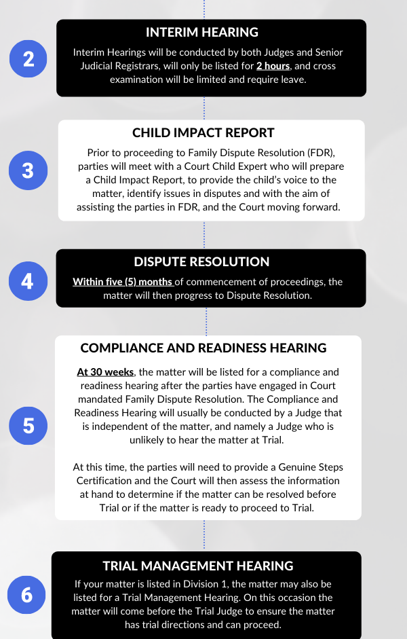
Application Process
Documents must be filed with court, at filing a court date will be allocated.
After filing sealed copies of documents must be served on other party (except for joint applications or documents signed by both parties)
After initiating proceedings potential court events:
Duty list hearing
Case Assessment Conference
Directions Hearing
Mention
Conciliation
Trial Management Hearing
Trial
Throughout the whole process,
lawyers are attempting to mediate.

Slide 30
What happens with the parenting orders?
Parents now have the legal obligation to follow the parenting orders.
Parents should seek legal advice if there have been breaches.
Breaching a court order is very serious, unless there is a reasonable excuse.
If the orders are not working, parents can apply if there has been a significant change in circumstances.
A childcare or other facility can only accept and comply with sealed court orders.
A letter from a lawyer or court orders that do not have the official court seal are not orders made by the court.
A reassurance from a parent that the orders are about to change is not acceptable.

Slide 31
Alice and George spend every alternate weekend with their father under the supervision of the paternal grandmother.

Slide 32
Rob does not pay any child support.
Samantha and Rob agreed he would pay for the children’s childcare instead.
Notes:
What is a reasonable excuse?
The person did not understand the obligations imposed by the order;
the person reasonably believed that the actions constituting the contravention were necessary to protect the health and safety of a person, including the person who contravened the order or the child, and
the contravention did not last longer than was necessary to protect the health and safety of the person who contravened the order or the child

Slide 33
Alice has now started attending school.

Slide 34
Samantha cannot contact Rob. She has not seen Alice in four days.

Slide 35
Recovery Order
A direction from the court to find and return a child.
VLA’s Recovery Order Kit

Slide 36
Referrals
Referrals from our community partners can be made directly via our website.
P: (03) 7037 3200 and press 2
E: info@southsidejustice.org.au

Slide 38
Pre-submitted questions
Systems abuse where the perpetrator has access to money.
Safety concerns for children where parenting orders in place.
Do FVIOs and breaches of FIVOs have any bearing on parenting orders?
What support is available to women who do not qualify for legal aid, but cannot afford private lawyers?
Do/can family lawyers provide any support for extending FIVOs and re breaches of FIVOs?
Accessing therapeutic supports where parenting orders stipulate that both parties need to consent to make medical decisions and perpetrator won’t agree.

Slide 39
Evaluation

Slide 40
Thank You!

